Slide 1
Chilled Water Energy Prediction
Evan Stinson
CAP 4630

Slide 2
Objectives
 | HVAC systems are essential in South Florida due to its history of a hot and humid climate, the demand for cooling has resulted in significant energy consumption which has a large impact financially on building owner's. The objective of this project is to use models that can predict HVAC energy usage which can help improve energy efficiency and identify opportunities to reduce operational costs.
 | Efficient energy consumption has become an increasingly important focus on utilities and energy usage organizations, with the sudden surge in data centers and the growing demand they place on the electrical grid, the need for strategies that reduce or optimize energy consumption has become even more urgent. As HVAC systems contribute to 50%-60% of a building owners electrical bill it is a great point to start looking at reduction strategies
 | The goal of this analysis is to identify patterns in energy usage that can be used to reduce building operating costs and improve overall system efficiency.

Slide 3
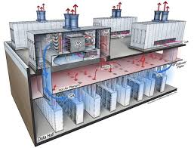
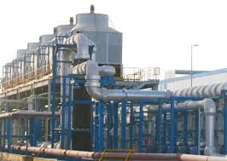
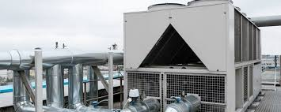

Slide 4
System Description – Dataset/AI Model(s)
The Dataset being used is the HVAC Energy Dataset. This is a publicly available dataset (Kaggle).
The dataset includes building metadata, weather data, meter readings, and timestamps.
The two AI models that will be used are Linear Regression and Random Forest Linear regression is used to reveal linear relationships between different variables in the model such as weather and building features.
Random Forest was chosen to show non-linear behaviors between variables. This was also chosen due to how large the dataset is.

Slide 5
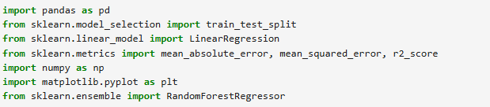
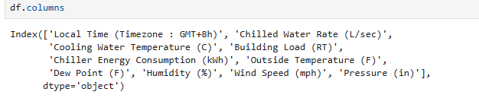
Dataset
Chilled water Dataset
https://www.kaggle.com/datasets/chillerenergy/chiller-energy-data
Y – Chiller Energy Consumption (kWh)
We will use the other variables to predict energy consumption.

Slide 6
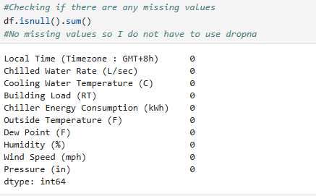
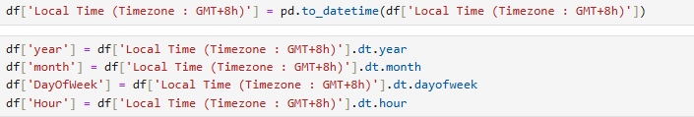
Pre-processing Data
Chilled water Dataset
-https://www.kaggle.com/datasets/chillerenergy/chiller-energy-data
Date time feature extraction was used to deriving separate components from a single timestamp. (year, month, day of week, and hour.

Slide 7
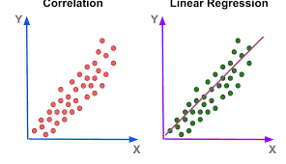
Model 1:
Linear Regression
Linear regression models measure the strength of the linear relationship between two continuous variables. In our case predicting energy consumptions from continuous environmental and operational variables.

Slide 8
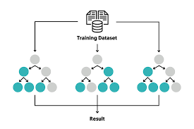
Model 2:
Random forest
Random forest predicts chilled waste energy consumptions by learning complex patterns from environmental and operational variables.

Slide 9
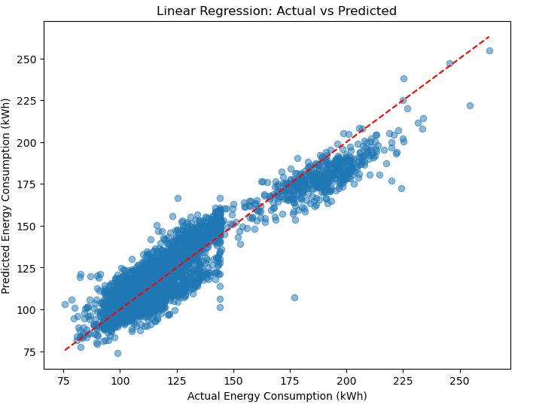

Linear Regression outputs

Slide 10
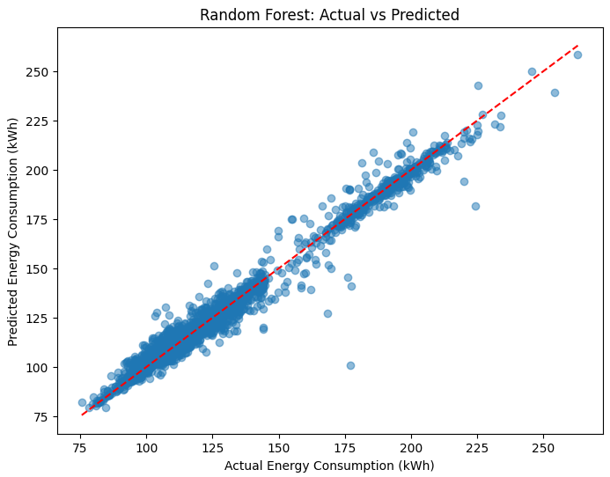

Random forest outputs

Slide 11
Experiment Considerations & Future Follow up experiments
Model is trained on a year of chiller data. Results may not be generalize to other buildings or years without retraining.
Accurate energy forecasting depends on knowing future environmental conditions because variables such as temperature, humidity and dew point strongly influence chiller load.

Slide 12
Questions?
Thanks!

